Slide 1
Digital System Design
Combinational Logic

Slide 2
Two digital circuit types
Combinational digital circuits:
  Consist of logic gates
  Their current outputs are determined from the present combination of inputs.
  Their operations can be specified logically by sets of Boolean functions.
Sequential digital circuits:
  Employ storage elements in addition to logic gates.
  Their outputs are a function of the inputs and the state of the storage elements.
  Their outputs depend on current inputs and past input.
  They have feedback connections.
Digital System Design
January 1, 2022

Slide 3
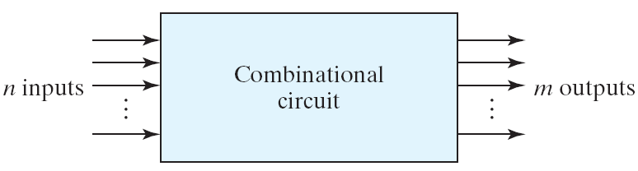
Combinational circuits
2^{n} possible combinations of input values
Specific functions
  Adders, subtractors, comparators, decoders, encoders, and multiplexers
MSI circuits or standard cells
Digital System Design
January 1, 2022

Slide 4
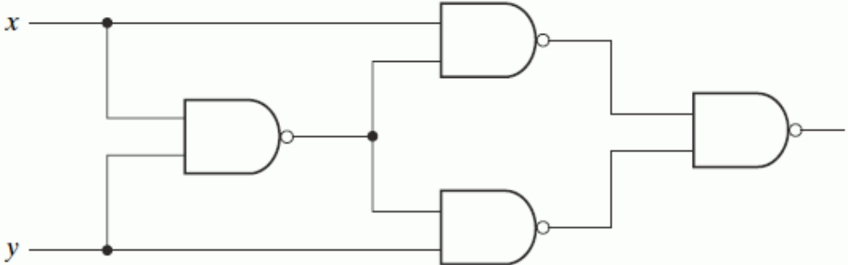
Analysis of A Combinational Circuit
make sure that it is combinational not sequential
  No feedback path
derive its Boolean functions (truth table)
design verification
a verbal explanation of its function
Ex. What is the output function of this circuit?
Digital System Design
January 1, 2022

Slide 5
Example Analysis
Analysis steps
  Label all gate outputs with symbols
  Find Boolean functions for all gates
  Express functions in terms of input variables + simplify
Substitution:
  F = (T2T3)’ = ((xT1)’(yT1)’)’ = (xT1)+(yT1) = x(xy)’+y(xy)’=
  =(x(x’+y’)) + (y(x’+y’)) = xx’+xy’+yx’+yy’ = xy’+yx’ = x ⊕ y
T₁=(xy)’
T₂=(x T₁)’
F=(T₂T₃)’
T₃=(yT₁)’
Digital System Design
January 1, 2022

Slide 6
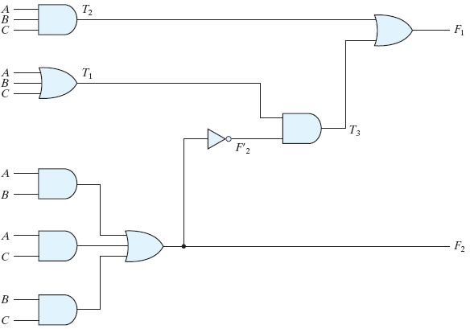
Example (1/3)
What are the output functions F₁ and F₂?
Digital System Design
January 1, 2022

Slide 7
Example (2/3)
Start with expressions that depend only on input variables:
  T₂ = ABC
  T₁ = A+B+C
  F₂ = AB + AC + BC
Express other outputs that depend on already defined internal signals
  T₃ = F₂’T₁
  F₁ = T₃ + T₂
Digital System Design
January 1, 2022

Slide 8
Example (3/3)
Simplify:
F₁ = T₃+T₂ = F₂’T1+ABC
= (AB+AC+BC)'(A+B+C)+ABC
= (A'+B')(A'+C')(B'+C')(A+B+C)+ABC
= (A'+B'C')(AB'+AC'+BC'+B'C)+ABC
= A'BC'+A'B'C+AB'C'+ABC
A full-adder
F₁: the sum
F₂: the carry
Digital System Design
January 1, 2022

Slide 9
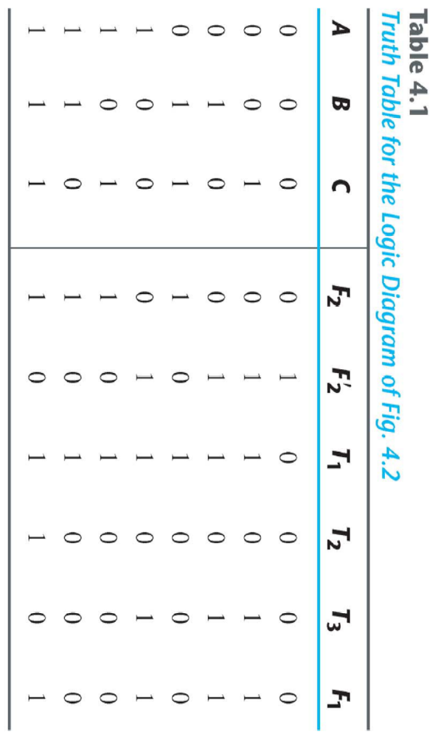
Truth Table
Digital System Design
January 1, 2022

Slide 10
Design of Combinational Circuit
The design procedure of combinational circuits
  State the problem (system spec.)
    determine the inputs and outputs
    the input and output variables are assigned symbols
  Derive the truth table
  Derive the simplified Boolean functions
  Draw the logic diagram and verify the correctness
Digital System Design
January 1, 2022

Slide 11
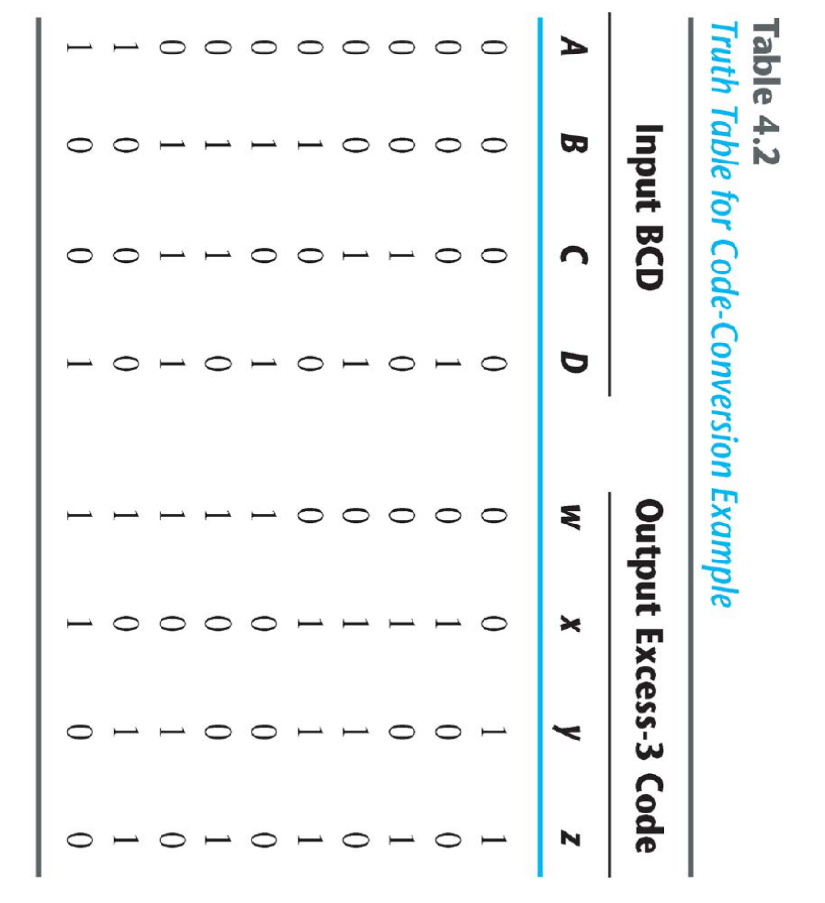
Code conversion example (1/3)
Design specification:
  Develop a circuit that converts aBCD digit into Excess-3 code
Step 1: inputs and outputs
  Input: BCD digit
    4 inputs: A, B, C, D
  Output: Excess-3 digit
    4 outputs: w, x, y, z
Step 2: truth table
Digital System Design
January 1, 2022

Slide 12
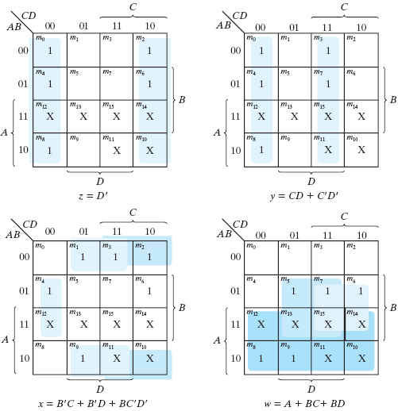
Code conversion example (2/3)
Step 3: minimize output functions
Digital System Design
January 1, 2022

Slide 13
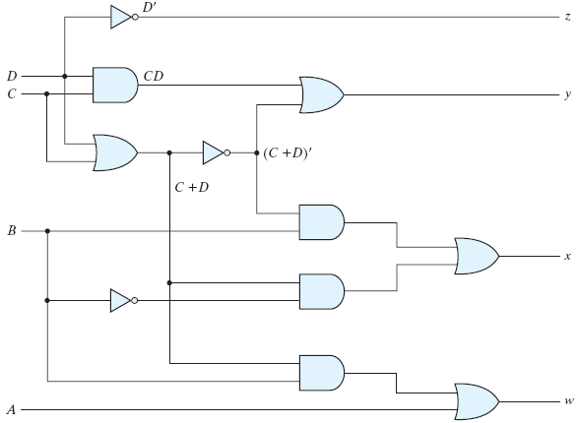
Code conversion example (3/3)
Step 4: circuit diagram (4 AND, 4 OR, 2 NOT gates)
Simplification:
  z =D’
  y =CD+C’D’
  =CD+(C+D)’
  x =B’C+B’D+BC’D’
  =B’(C+D)+BC’D’
  =B’(C+D)+B(C+D)’
  w =A+BC+BD
  =A+B(C+D)
Digital System Design
January 1, 2022

Slide 14
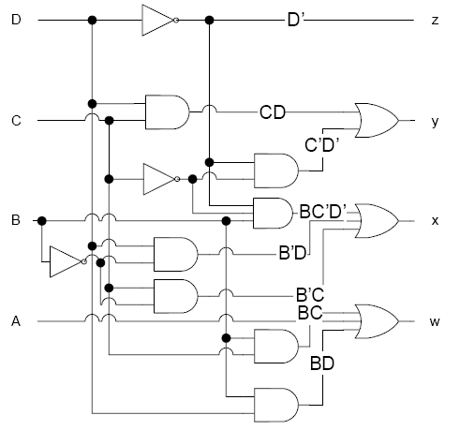
Alternate Solution
circuit diagram (7 AND,3 OR, 3 NOT gates)
Simplification:
z = D’
  y = CD +C’D’
  = CD + (C+D)’
  x = B’C+B’D+BC’D’
  w = A+BC+BD
Digital System Design
January 1, 2022

Slide 15
Binary Adders
Addition is important function in computer system
What does an adder have to do?
  Add binary digits
  Generate carry if necessary
  Consider carry from previous digit
Binary adders operate bit-wise
  A 16-bit adder uses 16 one-bit adders
Binary adders come in two flavors
  Half adder : adds two bits and generate result and carry
  Full adder : also considers carry input
  Two half adders make one full adder
Digital System Design
January 1, 2022

Slide 16
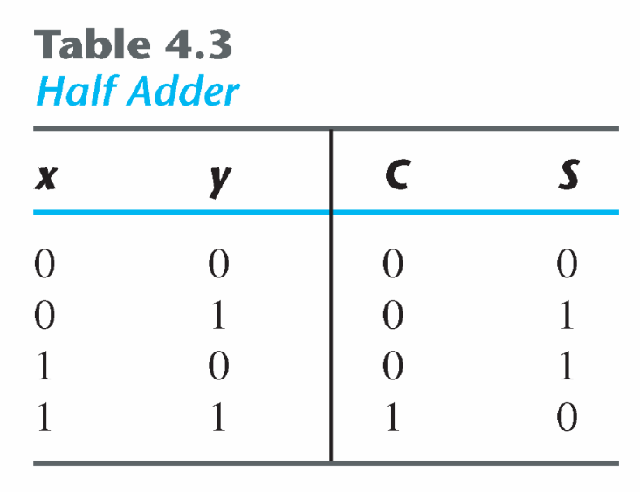
Binary Half Adder
Specification:
  Design a circuit that adds two bits and generates the sum and a carry
Outputs:
  Two inputs: x, y
  Two output: S (sum), C (carry)
  0+0=0 ; 0+1=1 ; 1+0=1 ; 1+1=10
The S output represents the least significant bit of the sum.
The C output represents the most significant bit of the sum or (a carry).
Digital System Design
January 1, 2022

Slide 17
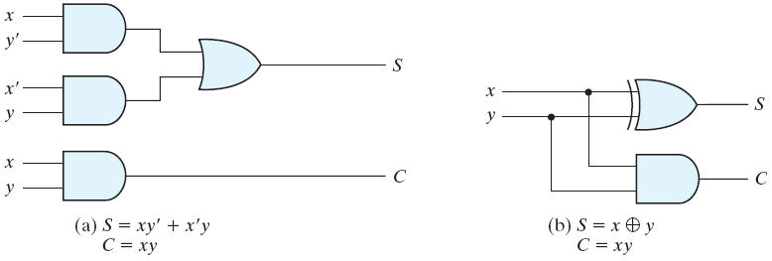
Implementation of Half Adder
the flexibility for implementation
S = x'y+xy’
C = xy
S=x ⊕ y
C = xy
X
Half
Adder
S
Y
C
Digital System Design
January 1, 2022

Slide 18
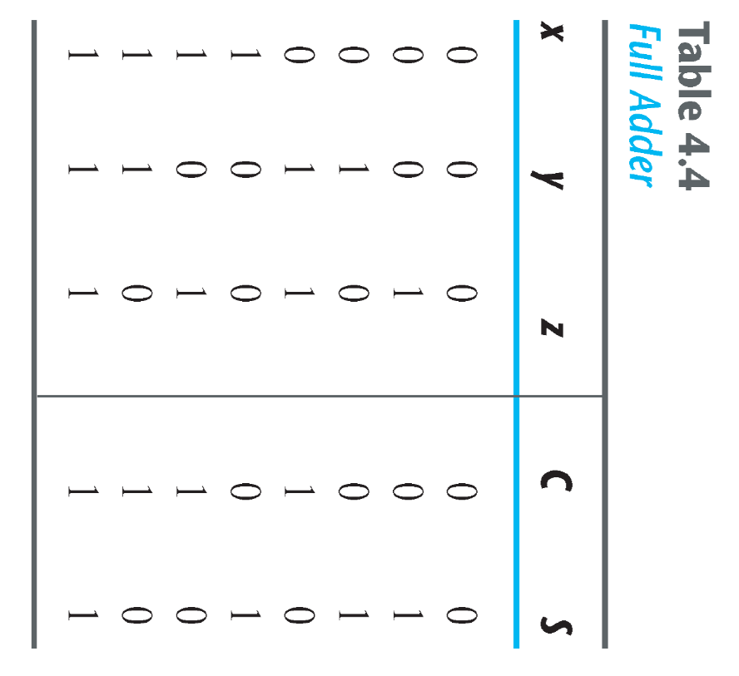
Full-Adder
Specification:
  A combinational circuit that forms the arithmetic sum of three bits and generates a sum and a carry
Inputs:
  Three inputs: x,y,z
  Two outputs: S, C
Truth table:
X
Y
C
Full
Adder
Z
S
Digital System Design
January 1, 2022

Slide 19
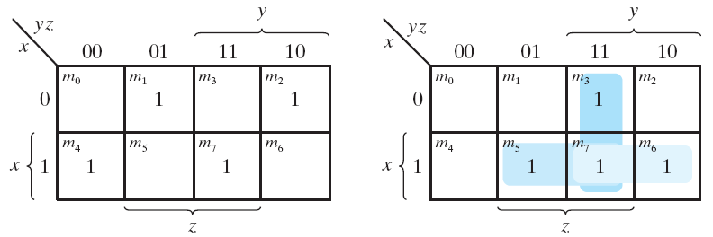
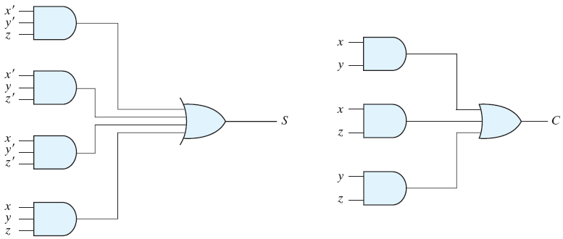
Implementation of Full Adder
S=x’y’z+ x’yz’ + xyz’ + xyz
C= xy + xz + yz
Digital System Design
January 1, 2022

Slide 20
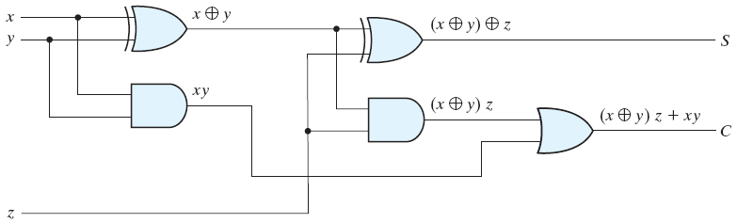
Alternative Implementation of Full Adder
S = z ⊕(x ⊕ y)= z’(xy’+x’y) + z(xy’+x’y)’
= z’(xy’+x’y) + z(xy+x’y’)
=xy’z’+x’yz’+ xyz +x’y’z
C = x y + (x ⊕ y) z
=z(xy’ + x’y) + xy= xy’z+ x’yz+ xy
= xy + xz + yz
Digital System Design
January 1, 2022

Slide 21
Binary Adder
A binary adder is a digital circuit that produces the arithmetic sum of two binary numbers.
A binary adder can be implemented using multiple full adders (FA).
Digital System Design
January 1, 2022

Slide 22
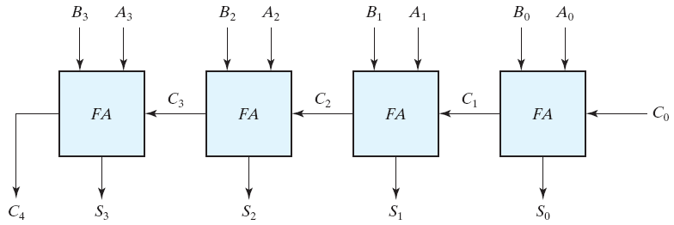
Example:4-bit binary adder
4-bit Ripple Carry Adder
Classical example of standard components
  Would require truth table with 2⁹ entries!
C 1 1 1 0
A 0 1 0 1
B 0 1 1 1
S 1 1 0 0
Digital System Design
January 1, 2022

Slide 23
Example: Add 2 binary numbers
A = 1011
B = 0011
Subscript i: | 3 | 2 | 1 | 0
Input carry Augend Addend | 0 1 0 | 1 0 0 | 1 1 1 | 0 1 1 | C_{i} A_{i} B_{i}
Sum Carry | 1 0 | 1 0 | 1 1 | 0 1 | S_{i} C_{i+1}
Digital System Design
January 1, 2022

Slide 24
Carry Propagation
In any combinational circuit, the signal must propagate through the gates before the correct output is available in the output terminals.
Total propagation time = the propagation delay of a typical gateX the number of gate levels
The longest propagation delay time in a binary adder is the time it takes the carry to propagate through the full adders. This is because each bit of the sum output depends on the value of the input carry. This makes the binary adder very slow.
Digital System Design
January 1, 2022

Slide 25
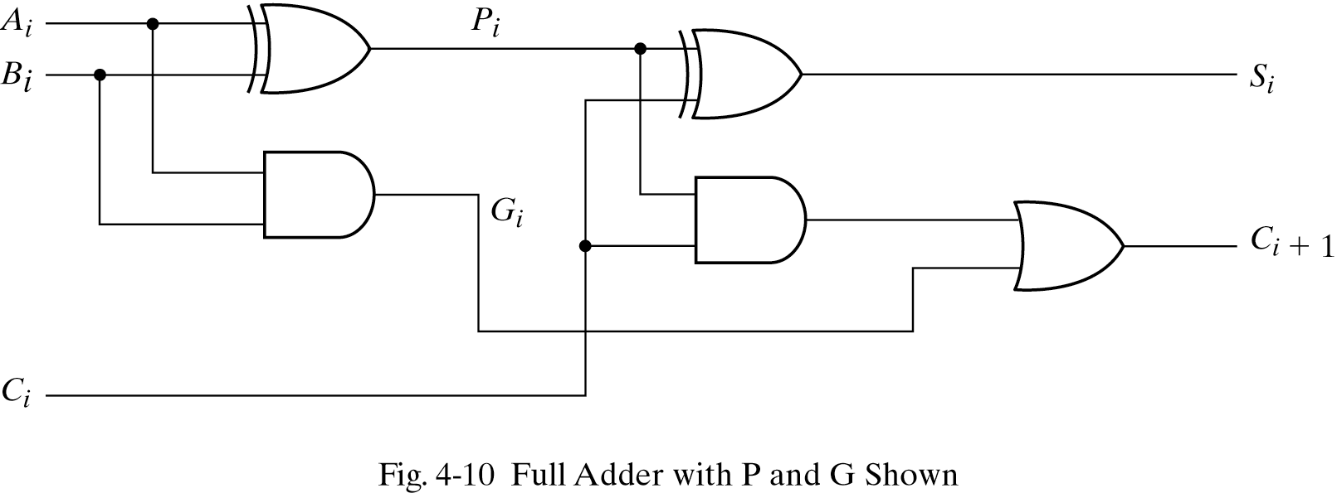
n-bit Carry Ripple Adders
In the expression of the sum C_{j} must be generated by the full adder at the lower position j-1.
The propagation delay in each full adder to produce the carry is equal to two gate delays = 2Δ
Since the generation of the sum requires the propagation of the carry from the lowest position to the highest position ,the total propagation delay of the adder is approximately:
Total Propagation delay = 2nΔ
Digital System Design
January 1, 2022

Slide 26
Carry-Lookahead Adder
Full adder: S_{i} = A_{i} ⊕ B_{i} ⊕ C_{i} , C_{i+1} = A_{i} B_{i} + (A_{i} ⊕ B_{i} ) C_{i}
Create new signals:
  G_{i} = A_{i} B_{i} “carry generate” for stage i
  P_{i} = A_{i} ⊕ B_{i} “carry propagate” for stage i
Full adder equations expressed in terms of G_{i} and P_{i}
  S_{i} = P_{i} ⊕ C_{i}
  C_{i+1} = G_{i} + P_{i} C_{i}
Digital System Design
January 1, 2022

Slide 27
Carry Lookahead - Equations
Full adder functionality can be expressed recursively
  S_{i} = P_{i} ⊕ C_{i}
  C_{i+1} = G_{i} + P_{i} C_{i}
Carry of each stage
  C₀ = input carry
  C₁ = G₀ + P₀C₀
  C₂ = G₁ + P₁C₁ = G₁ + P₁(G₀ + P₀C₀) = G₁ + P₁G₀ + P₁P₀C₀
  C₃ = G₂ + P₂C₂ = … = G₂ + P₂G₁ + P₂P₁G₀ + P₂P₁P₀C₀
  C₄ = G₃ + P₃G₂ + P₃P₂G₁ + P₃P₂P₁G₀ + P₃P₂P₁P₀C₀
Digital System Design
January 1, 2022

Slide 28
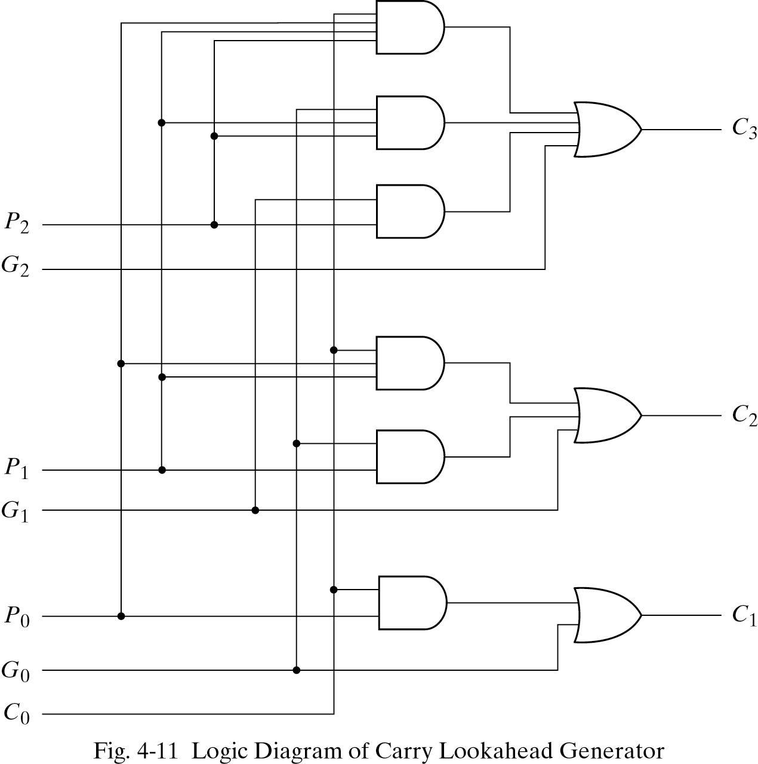
Carry Lookahead - Circuit
Digital System Design
January 1, 2022

Slide 29
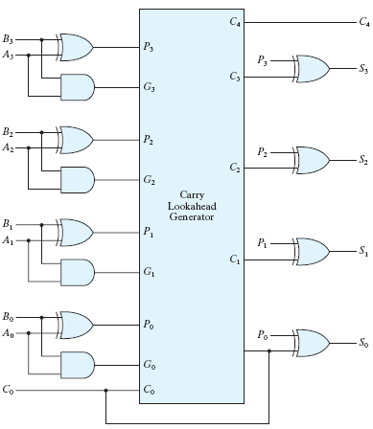
4-bit Adder with Carry Lookahead
Complete adder:
  Same number of stages for each bit
Drawback?
  Increasing complexity of lookahead logic for more bits
Digital System Design
January 1, 2022

Slide 30
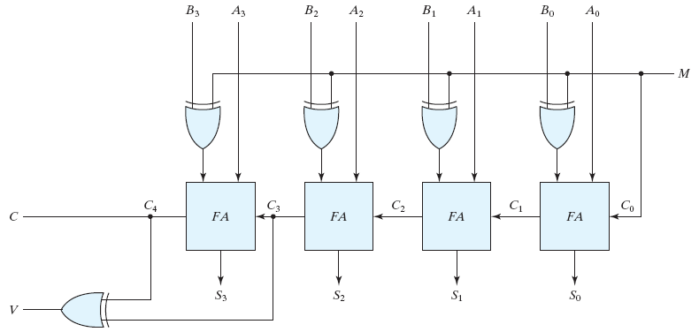
Four-bit adder-subtractor
M sets mode: M=0addition and M=1subtraction
M is a “control signal” (not “data”) switching between Add and Subtract
If v=0 no overflow
If v=1 overflow occur
Digital System Design
January 1, 2022

Slide 31
Overflow Conditions
Overflow conditions
  There is no overflow if signs are different (pos + neg, or neg + pos)
  Overflow can happen only when both numbers have same sign, and
  If carry into sign position and out of sign position differ
  Example: 2’s complement signed numbers wih n = 4 bits
  Result would be correct with extra position
  Detected by XOR gate ( output =1 when inputs differ)
  Can be used as input carry for next adder circuit
+6 0 110
+7 0 111
---------------------
+13 0 1 101
-6 1 010
-7 1 001
---------------------
-13 1 0 011
Digital System Design
January 1, 2022

Slide 32
Addition cases and overflow
00
0010
0011
--------
0101
01
0011
0110
--------
1001
11
1110
1101
--------
1011
10
1101
1010
--------
0111
00
0010
1100
--------
1110
11
1110
0100
--------
0010
2
3
5
3
6
-7
-2
-3
-5
-3
-6
7
2
-4
-2
-2
4
2
OFL
OFL
Digital System Design
January 1, 2022

Slide 33
BCD Adder
Add two BCD's
  9 inputs: two BCD's and one carry-in
  5 outputs: one BCD and one carry-out
Design approaches
  A truth table with 2⁹ entries
  use binary full Adders
  the sum <= 9+9+1 = 19
  binary to BCD
Digital System Design
January 1, 2022

Slide 34
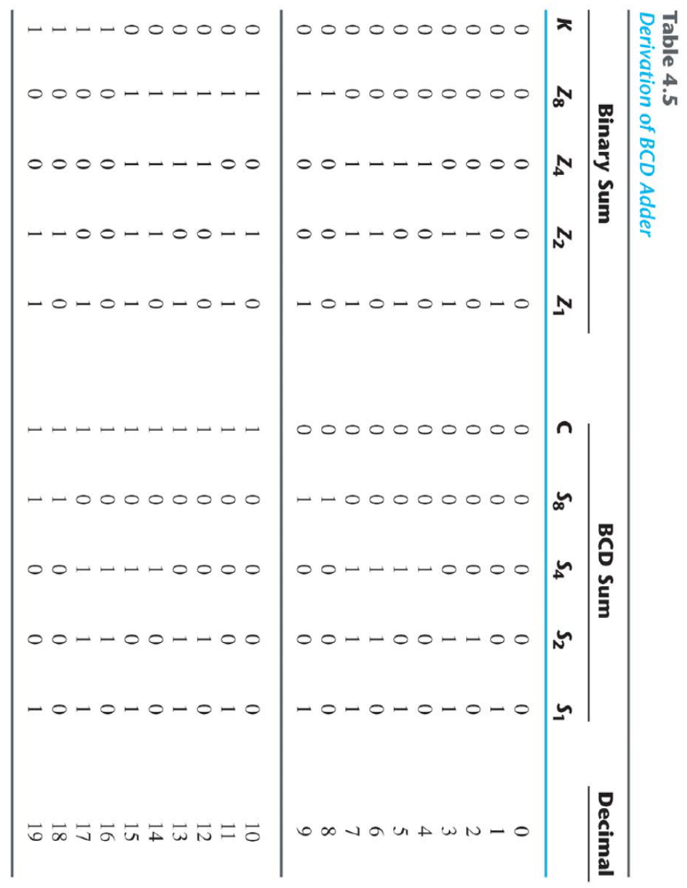
Truth Table
Digital System Design
January 1, 2022

Slide 35
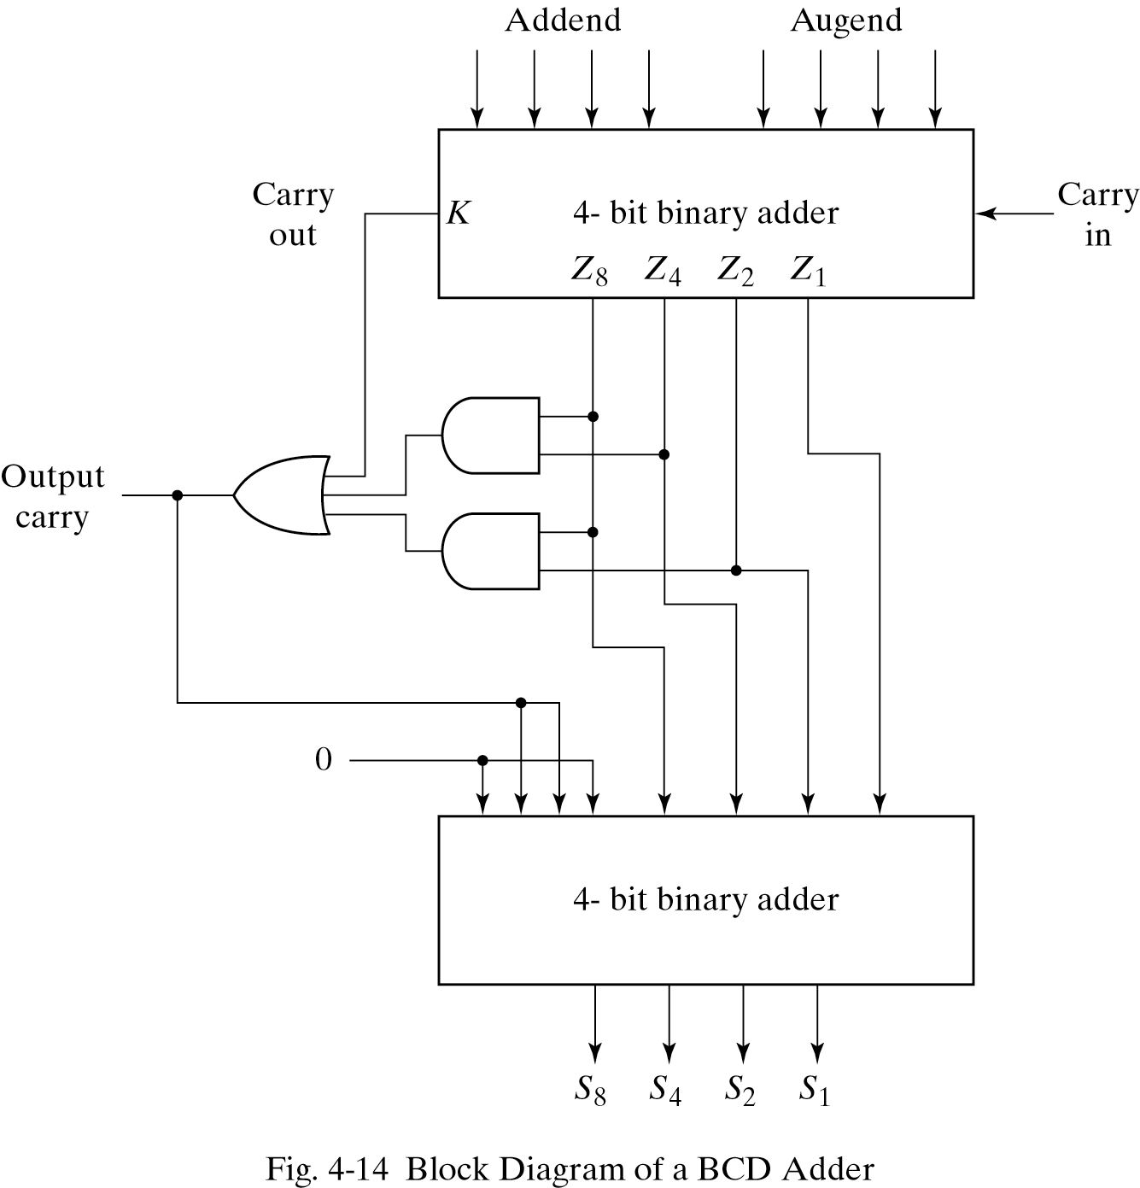
BCD Adder Circuit
Modifications are needed if the sum > 9
  C = 1
  K = 1
  Z₈Z₄ = 1
  Z₈Z₂ = 1
  modification: -(10)d or +6
Digital System Design
January 1, 2022

Slide 36
Binary Multiplication
Multiplication is achieved by adding a list of shifted multiplicands according to the digits of the multiplier.
Ex. (unsigned)
11 1 0 1 1 multiplicand (4 bits)
X 13 X 1 1 0 1 multiplier (4 bits)
-------- -------------------
33 1 0 1 1
11 0 0 0 0
______ 1 0 1 1
143 1 0 1 1
---------------------
1 0 0 0 1 1 1 1 Product (8 bits)
Digital System Design
January 1, 2022

Slide 37
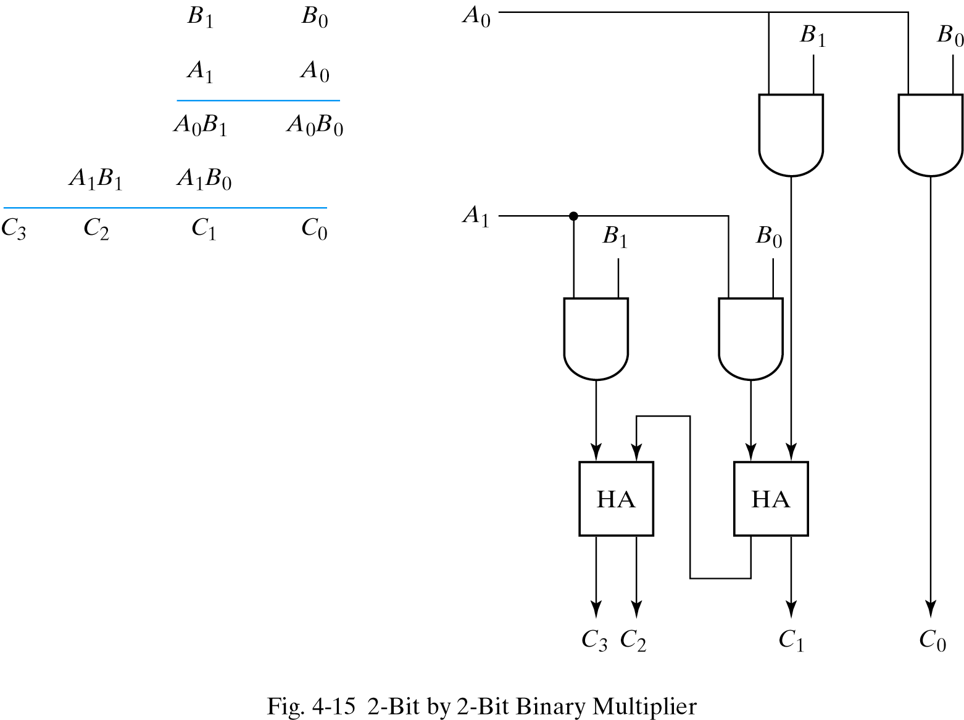
Binary Multiplier
Partial products – AND operations
Digital System Design
January 1, 2022

Slide 38
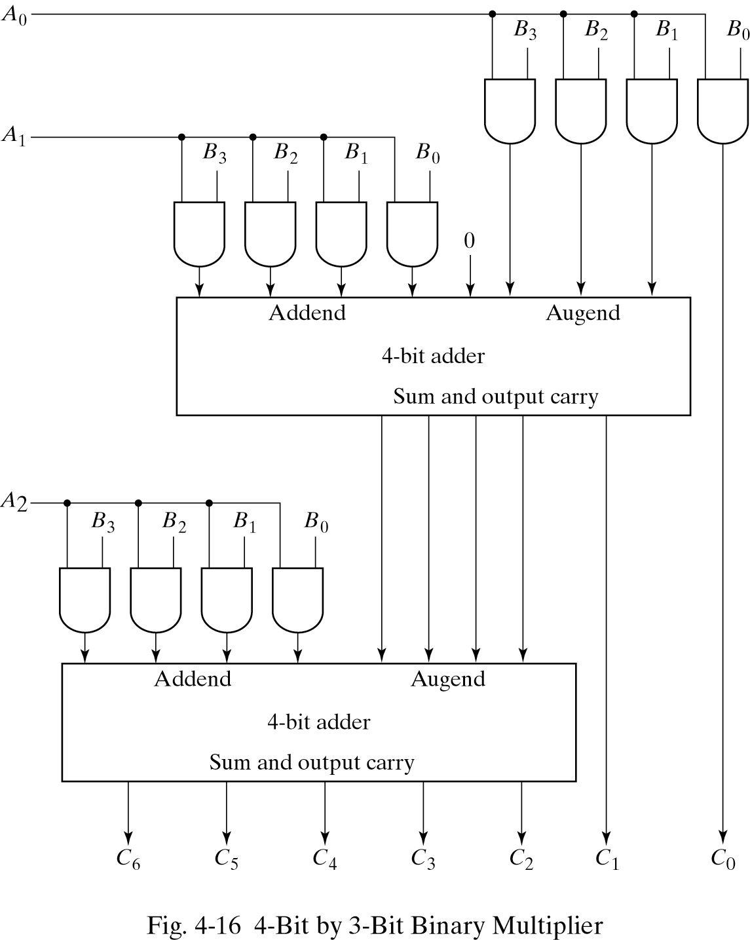
4-bit by 3-bit binary multiplier
Digital System Design
January 1, 2022

Slide 39
Binary Multiplication
An n-bit X n-bit multiplier can be realized in combinational circuitry by using an array of n-1 n-bit adders where is adder is shifted by one position.
For each adder one input is the multiplied by 0 or 1 (using AND gates) depending on the multiplier bit, the other input is n partial product bits.
X₃ X₂ X₁ X₀
x Y₃ Y₂ Y₁ Y₀
----------------------------------------------
X₃.Y₀ X₂.Y₀ X₁.Y₀ X₀.Y₀
X₃.Y₁ X₂.Y₁ X₁.Y₁ X₀.Y₁
X₃.Y₂ X₂.Y₂ X₁.Y₂ X₀.Y₂
X₃.Y₃ X₂.Y₃ X₁.Y₃ X₀.Y₃
_______________________________________________________________________________________________________________________________________________
P₇ P₆ P₅ P₄ P₃ P₂ P₁ P₀
Digital System Design
January 1, 2022

Slide 40
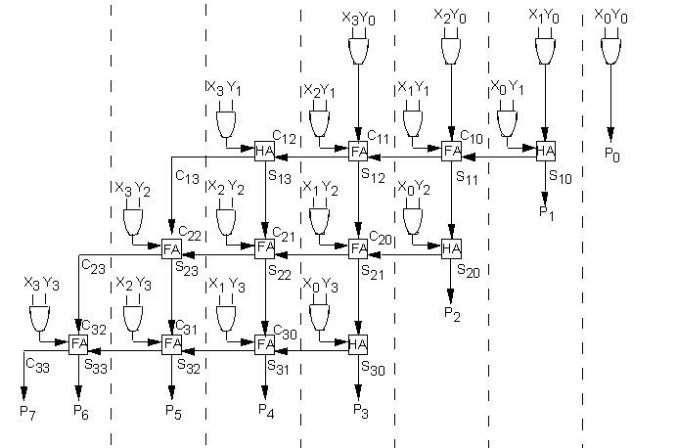
4x4 Array Multiplier
Digital System Design
January 1, 2022

Slide 41
Magnitude Comparator (1/2)
Need to compare two numbers: A and B
  A > B ?, A = B ?, A < B ?
How many truth table entries for n-bit numbers?
  2^{2n} entries
  Impractical for design
How can we determine that two numbers are equal?
  Equal if every digit is equal
  A₃A₂A₁A₀ = B₃B₂B₁B₀ iff
  A₃ = B₃ and A₂ = B₂ and A₁ = B₁ and A₀=B₀
New function: xi indicates if A_{i} = B_{i}
  x_{i} = A_{i}B_{i} + A_{i}’B_{i}’ (XNOR)
  Thus, (A = B) = x₃x₂x₁x₀
What about A < B and A > B?
Digital System Design
January 1, 2022

Slide 42
Magnitude Comparator (2/2)
Case 1: A > B
  How can we tell that A > B?
  Look at most significant bit where A and B differ
    If A = 1 and B = 0, then A > B
    If not, then A ≤ B
Function (n = 4) :
  If difference in first digit: A₃B₃’
  If difference in second digit: x₃A₂B₂’
    Conditional that A₃ = B₃ (x₃ =1 if : A₃=B₃ )
  Similar for all other digits
Comparison function A > B:
  (A > B) = A₃B₃’+ x₃A₂B₂’ + x₃x₂A₁B₁’ + x₃x₂x₁A₀B₀’
Case 2: A < B
  swap A and B for A < B
Digital System Design
January 1, 2022

Slide 43
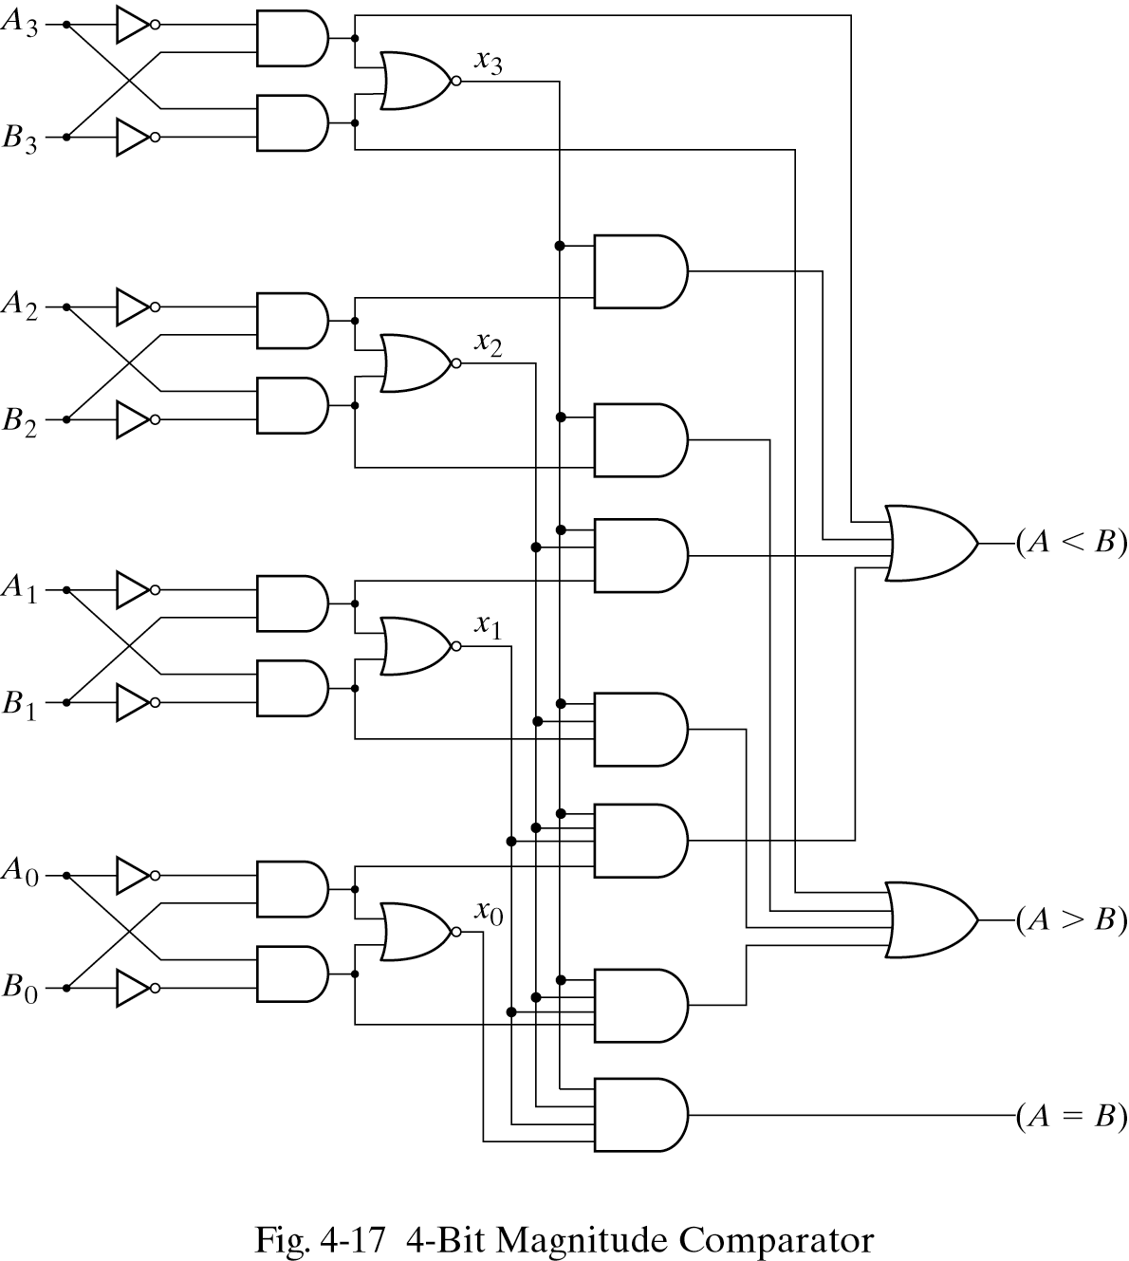
Magnitude Comparator Circuit
Functions:
  (A = B) = x₃x₂x₁x₀
  (A > B) = A₃B₃’+ x₃A₂B₂’ +
  x₃x₂A₁B₁’ + x₃x₂x₁A₀B₀’
  (A < B) = A₃’B₃+ x₃A₂’B₂ +
  x₃x₂A₁’B₁ + x₃x₂x₁A₀’B₀
Can be extended to arbitrary number of bits
Size grows with n² (n = number of bits)
Digital System Design
January 1, 2022

Slide 44
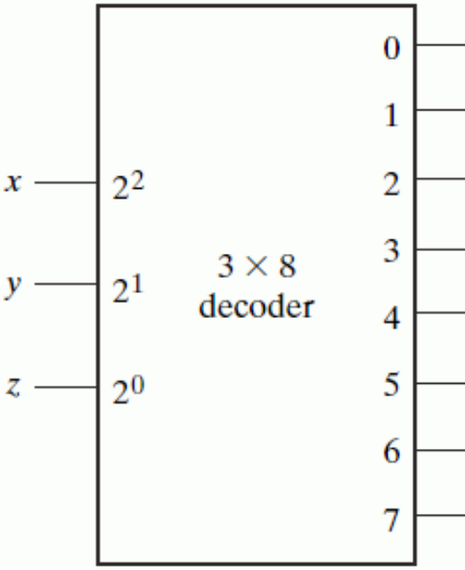
Decoders
Decoder : selects one output based on binary input
  Converts n-bit code into 2^{n} outputs, only one being active for any combination of inputs
  Selects output x if input is binary representation of x
Applications
  Binary-to-octal decoder
  Memory address selection
  Selection of any kind
  Can be used to construct arbitrary logic function
Digital System Design
January 1, 2022

Slide 45
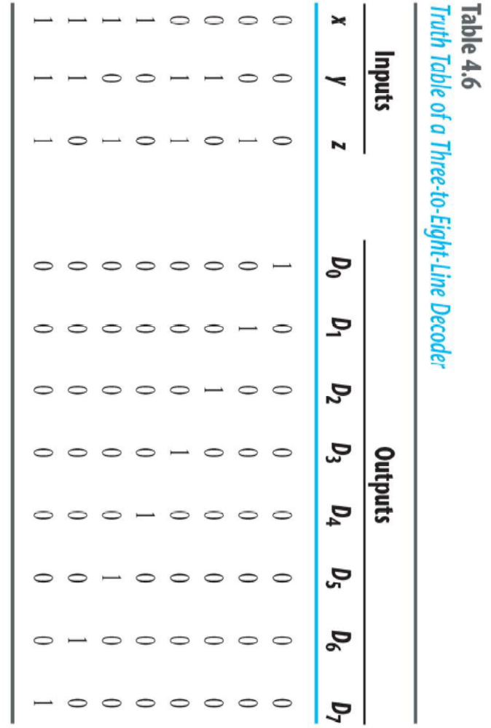
Truth Table
Digital System Design
January 1, 2022

Slide 46
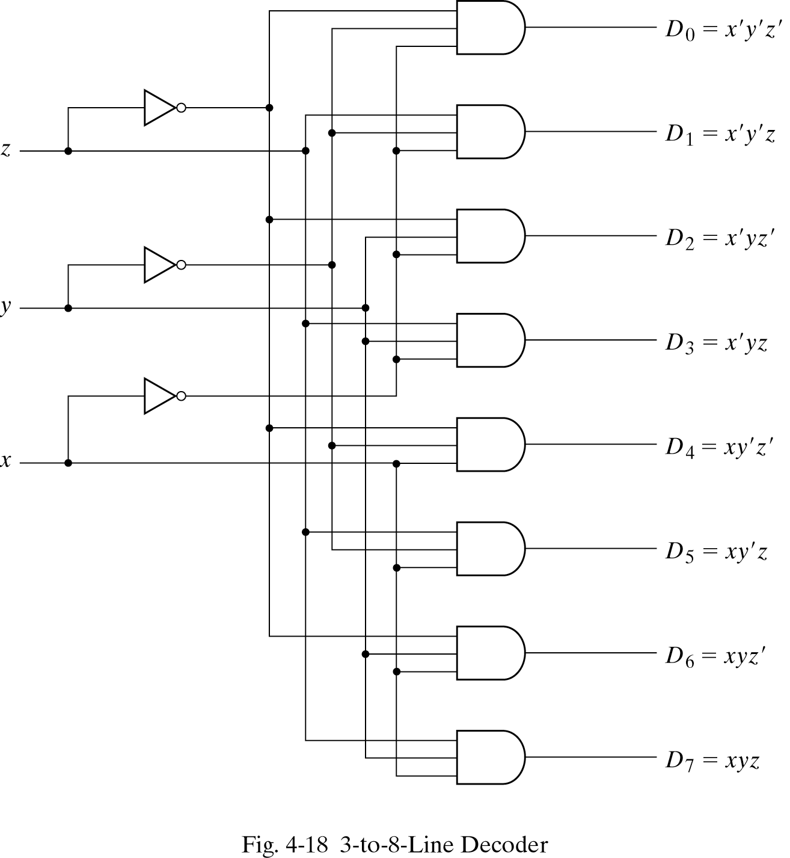
3 to 8 Decoder Circuit
When is output 0 chosen?
  If x’ y’ z’
When is output 1 chosen?
  If x’ y’ z
… and so on …
Circuit for line decoder
  Sequence of minterms
  Combine variables to minterms
Digital System Design
January 1, 2022

Slide 47
Enabling
Enable signals permit or prevent something from occurring (a control signal)
  State is described as either:
    Active - ON or Enabled
    Passive - OFF or Disabled
  Polarity of control state can be:
    Active high - schematic symbol doesn’t have bubble
    Active low - Schematic symbol has bubble
Digital System Design
January 1, 2022

Slide 48
Advanced Decoder
Additional feature: Enable input
  Circuit generates output only if Enable is selected (E=0)
  If disabled (E=1), no output line is picked
Example:
  2-to-4 line decoder with Enable
  NAND implementation
Digital System Design
January 1, 2022

Slide 49
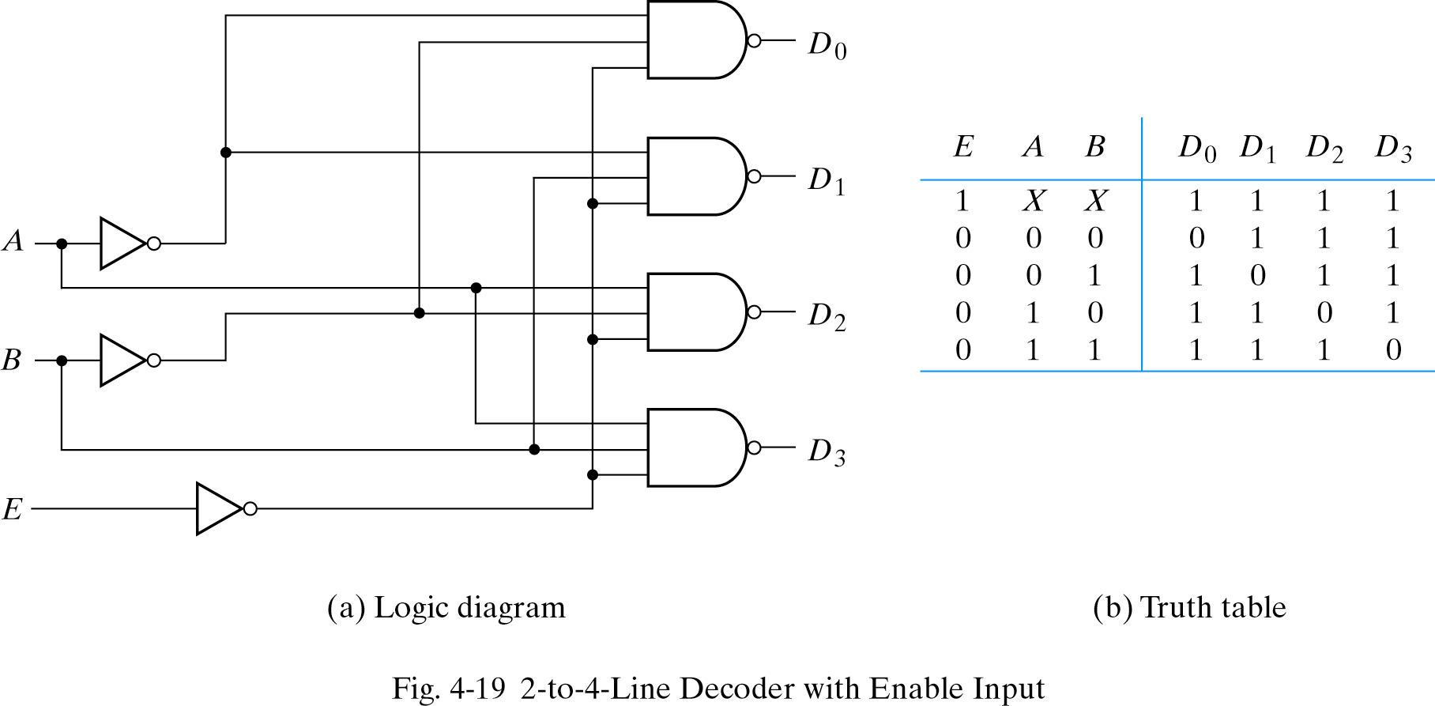
2-to-4 Line Decoder with Enable Input
Truth table for NAND decoder
  Complemented outputs and Enable
If active low outputs, then use NAND gates!
Digital System Design
January 1, 2022

Slide 50
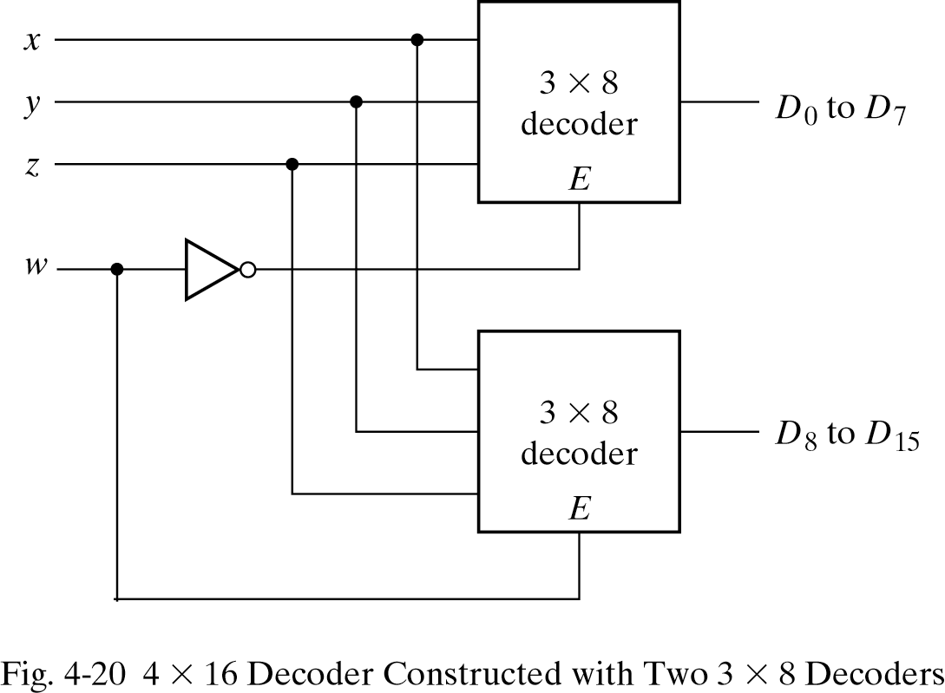
Larger Decoders
Enable bit can be used for building larger decoders
  w = 0 activates upper decoder (bits D₇…D₀)
  w = 1 activates lower decoder (bits D₁₅…D₈)
Effect: w adds one input bit
  n = 3 → 4
Can we use new decoder to get a 5-to-32 line decoder?
  No!
  4-to-16 line decoder does not have Enable
Digital System Design
January 1, 2022

Slide 51
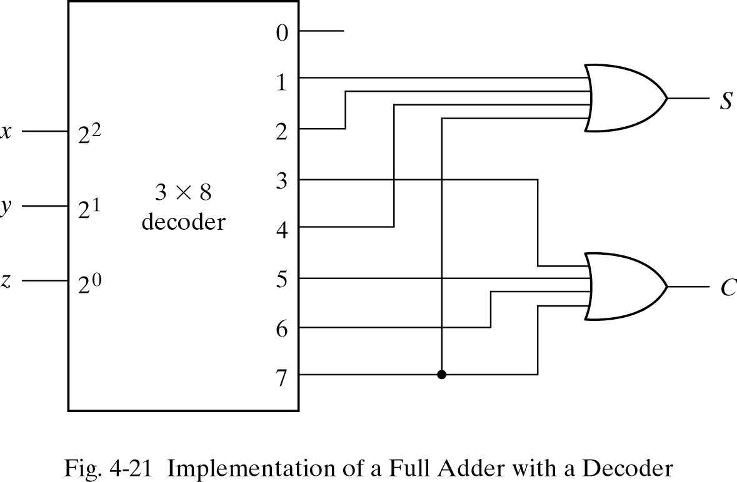
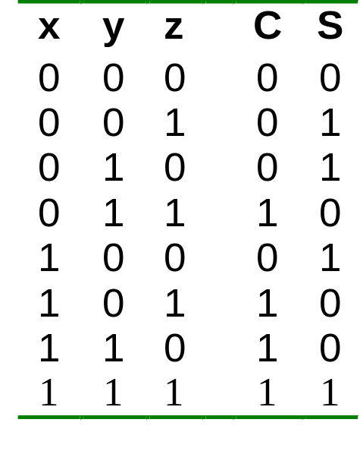
Implementing Functions Using Decoders
Example: Full adder
  S(x, y, z) = Σ (1,2,4,7)
  C(x, y, z) = Σ (3,5,6,7)
Digital System Design
January 1, 2022

Slide 52
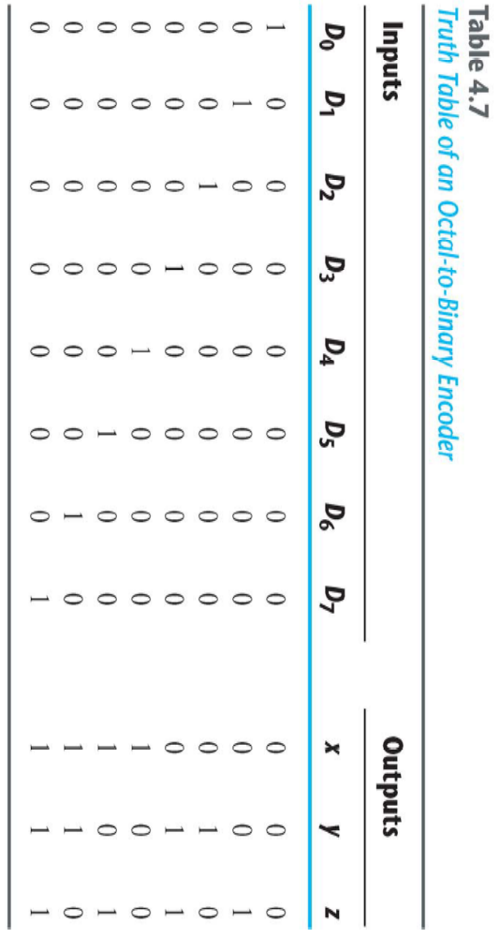
Encoders
Encoder: translates 2^{n} input lines into n output lines
  Input: 2^{n} lines
  Output: n bits
  Output is binary coding of input that is 1
Truth table (n=3):
Digital System Design
January 1, 2022

Slide 53
8-to-3 binary encoder
For an 8-to-3 binary encoder with inputs D₀-D₇ the logic expressions of the outputs X,Y,Z are:
Z = D₁ + D₃ + D₅ + D₇
Y = D₂ + D₃ + D₆ + D₇
X = D₄ + D₅ + D₆ +D₇
At any one time, only one input line has a value of 1.
D₀
D₁
D₂
D₃
D₄
D₅
D₆
D₇
X = D₄ + D₅ + D₆ + D₇
Y = D₂ + D₃ + D₆ + D₇
Z = D₁ + D₃ + D₅ + D₇
Digital System Design
January 1, 2022

Slide 54
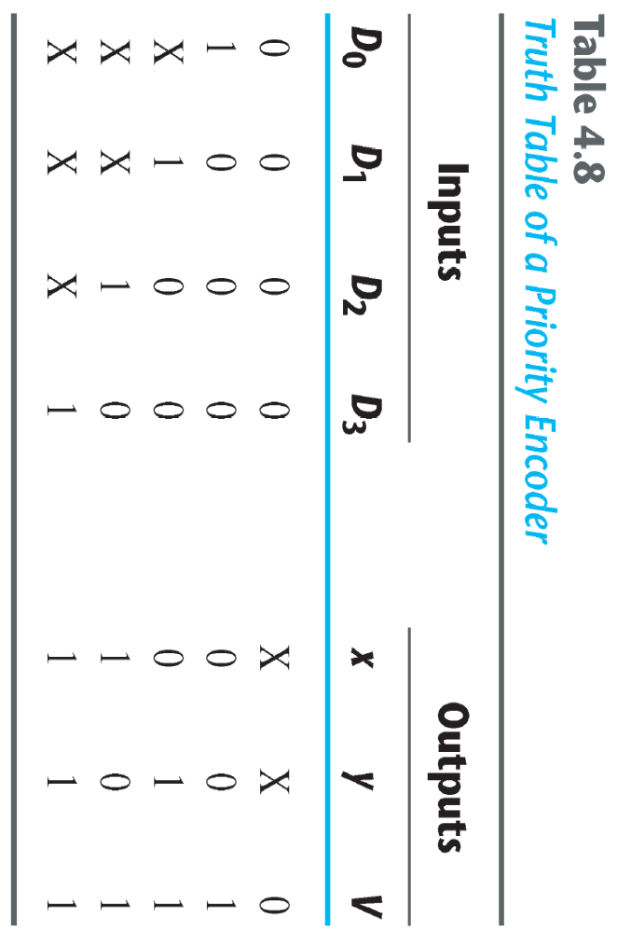
Priority Encoder
Priority encoder
  Like encoder, with additional functionality:
    if multiple inputs are 1, give priority to one of the bits
Example: 4-to-1 priority encoder with priority given to one bit
Which bit has highest priority?
  D3
Valid bit
Digital System Design
January 1, 2022

Slide 55
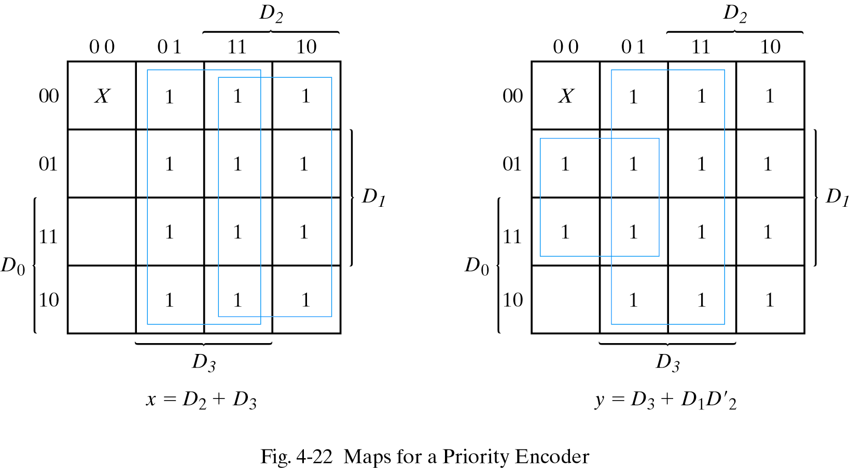
K-Map of a Priority Encoder
Digital System Design
January 1, 2022

Slide 56
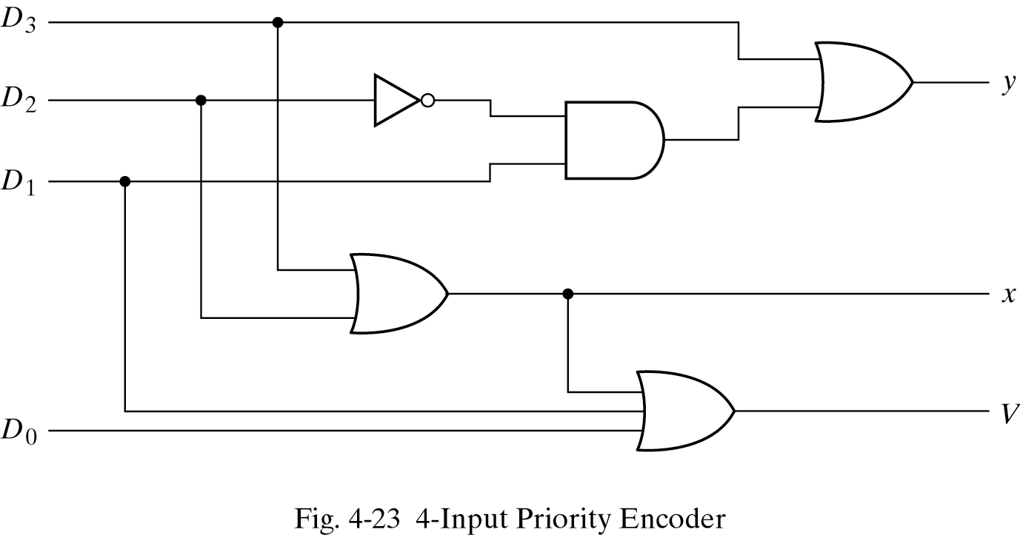
4-input Priority Encoder
x = D2 + D3
y = D3 + D1 D2’
V = D0 + D1 + D2 + D3
Digital System Design
January 1, 2022

Slide 57
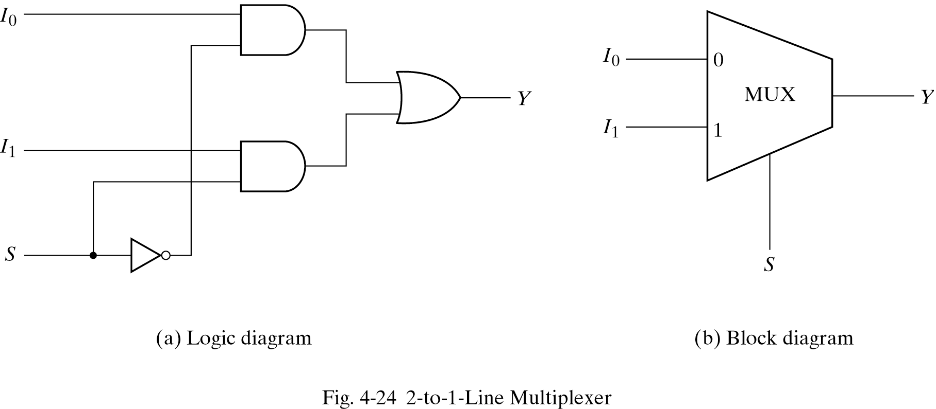
Multiplexers
select binary information from one of many input lines and direct it to a single output line
2^{n} input lines, n selection lines and one output line
e.g.: 2-to-1-line multiplexer
Digital System Design
January 1, 2022

Slide 58
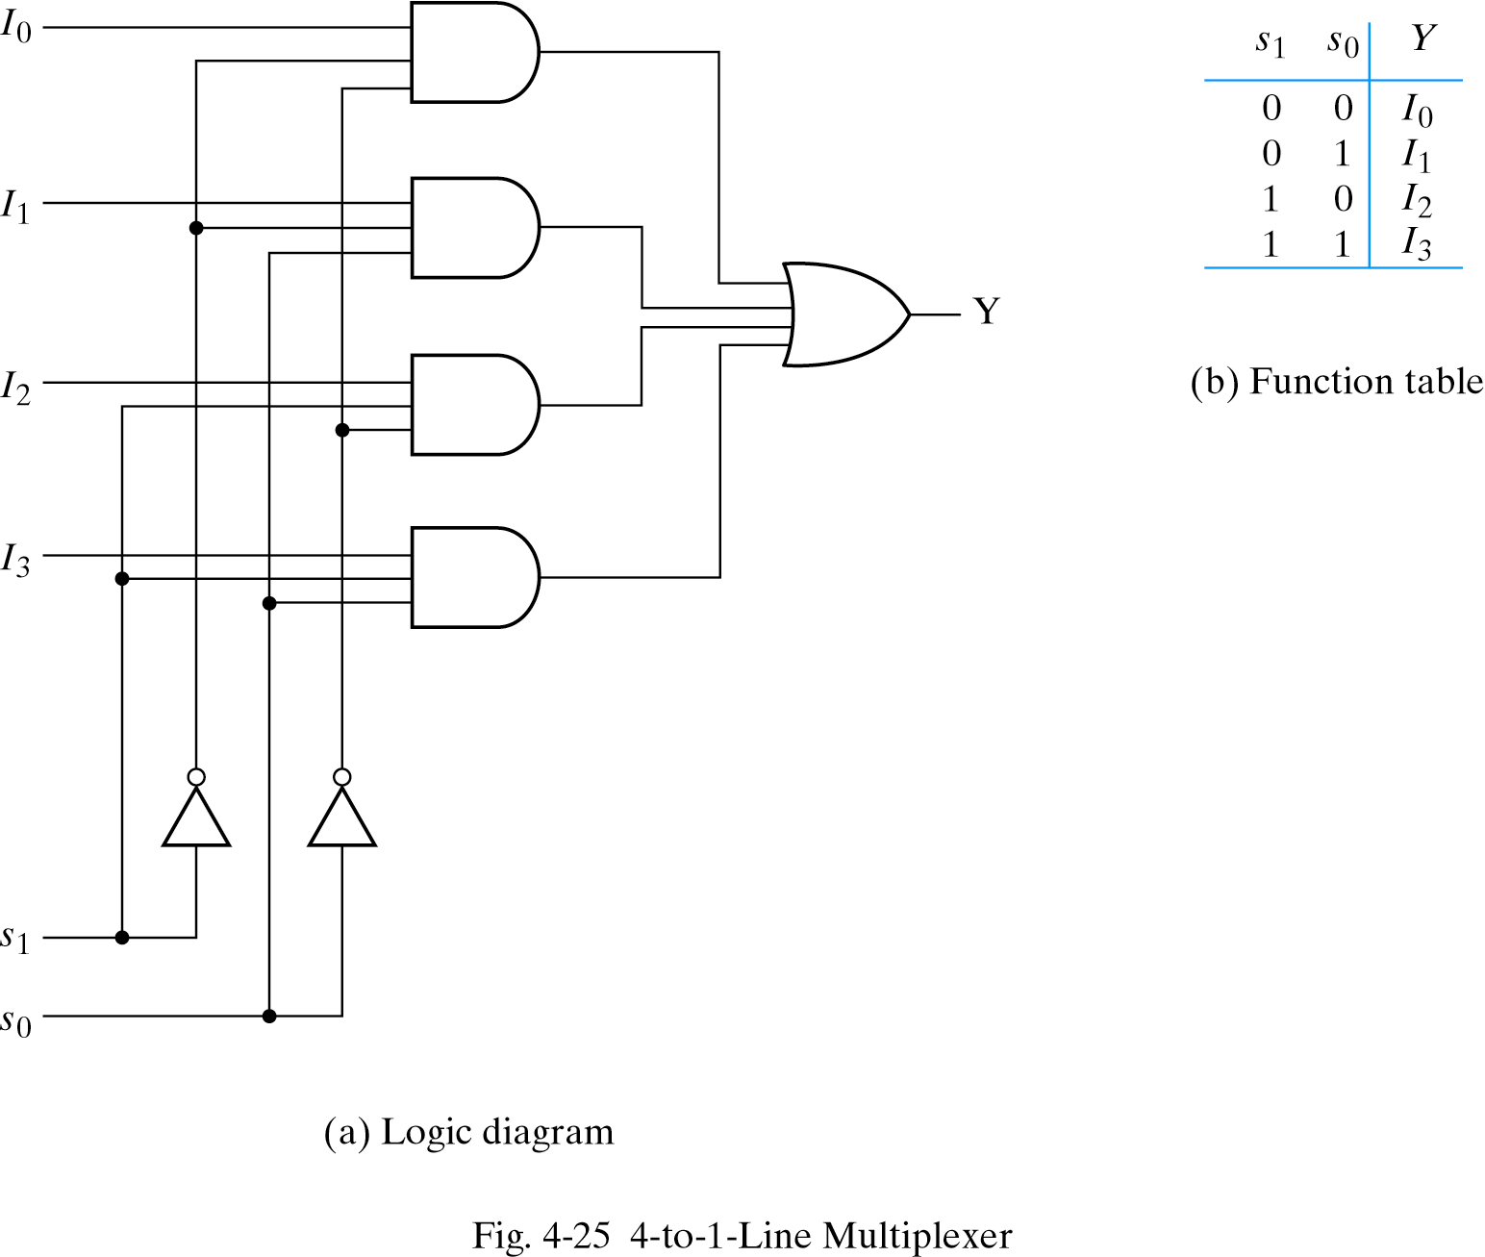
4-to-1-line multiplexer
Inputs
Inputs
I₀
0
1
2
3
I₀
I₁
4:1
MUX
I₁
I₂
Y
Output
I₂
mux
Y
I₃
I₃
S₁ S₀
select
S₁ S₀
select
Digital System Design
January 1, 2022

Slide 59
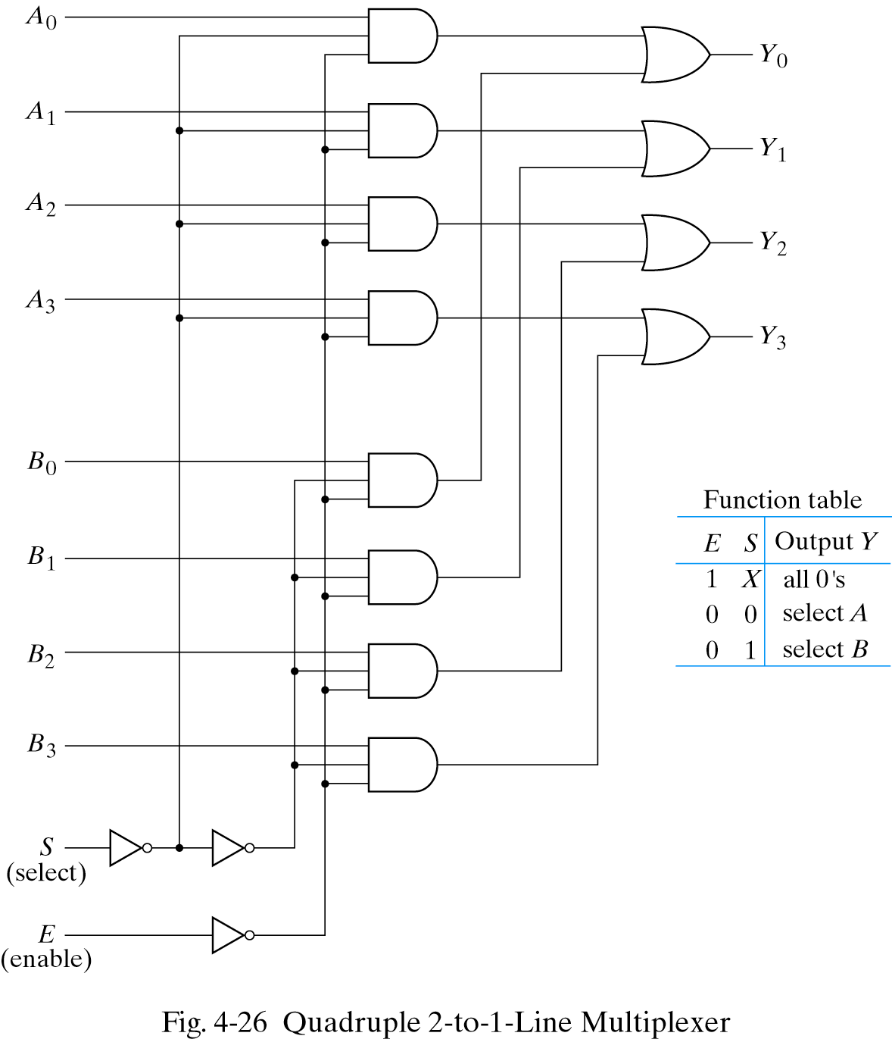
Multiplexer
What if we want to select more than one bit?
Example: choose one of two 4-bit numbers
“Quadruple2-to-1 line multiplexer”
Select chooses input
Enable bit sets output to 0 if 1
Digital System Design
January 1, 2022

Slide 60
Alternative Circuit for 4-to-1-line multiplexer
I₀
I₁
Y
I₂
I₃
0 1 2 3
2-to-4 Decoder
S₁
S₀
Digital System Design
January 1, 2022

Slide 61
Boolean function implementation
MUX: a decoder + an OR gate
2n-to-1 MUX can implement any Boolean function of n input variable
a better solution: implement any Boolean function of n+1 input variable
  n of these variables: the selection lines
  the remaining variable: the inputs
Digital System Design
January 1, 2022

Slide 62
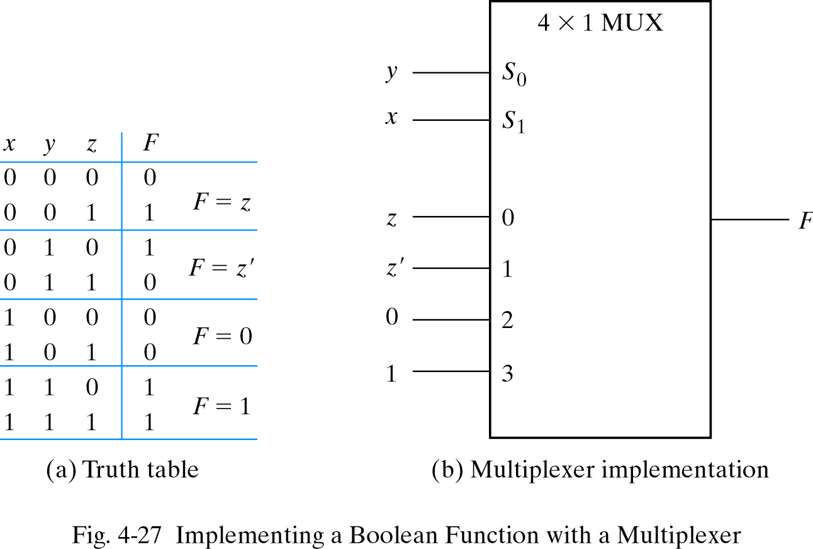
Example I
an example: F(x,y,z)=Σ(1,2,6,7)
Digital System Design
January 1, 2022

Slide 63
Procedure
Procedure:
  assign an ordering sequence of the input variable
  the rightmost variable will be used for the input lines
  assign the remaining n-1 variables to the selection lines w.r.t. their corresponding sequence
  construct the truth table
  consider a pair of consecutive minterms starting from m₀
  determine the input lines
Digital System Design
January 1, 2022

Slide 64
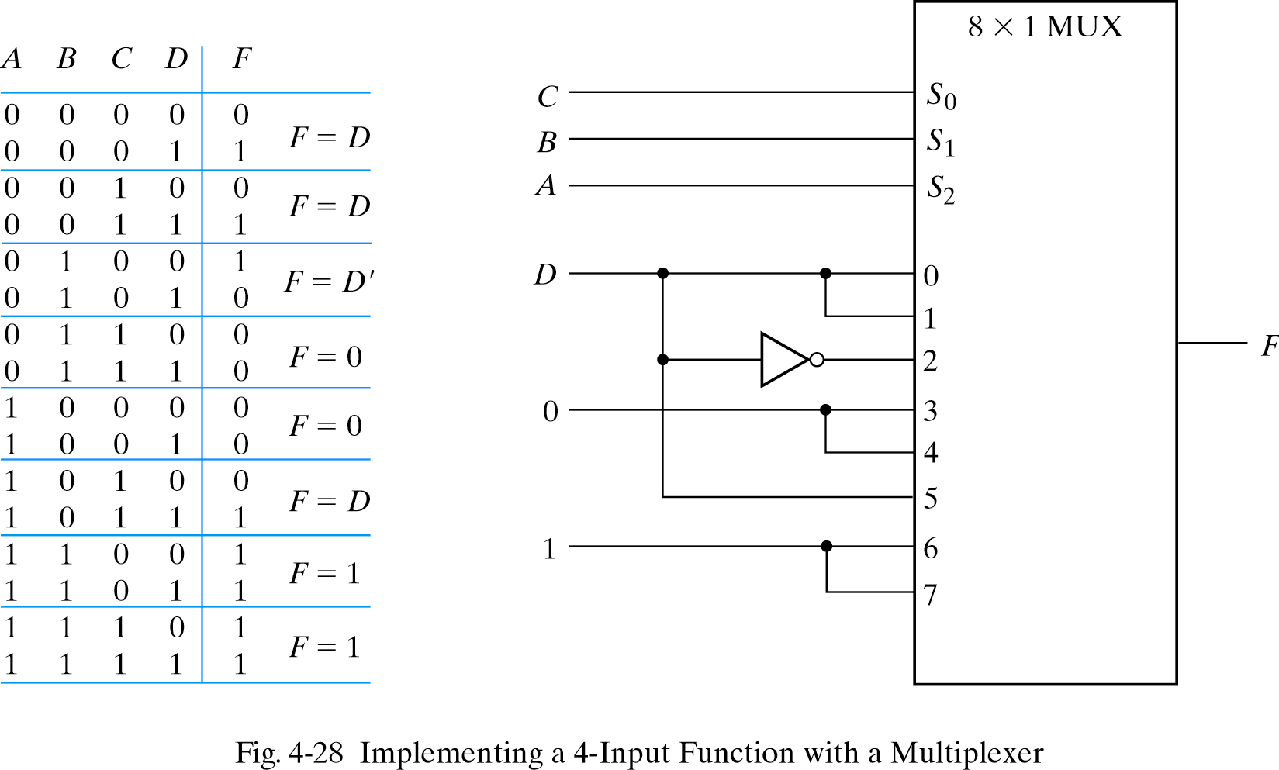
Example II
an example: F(A,B,C,D)=Σ(1,3,4,11,12,13,14,15)
Digital System Design
January 1, 2022

Slide 65
Demultiplexers
Digital switches to connect data from one input source to one of n outputs.
Usually implemented by using n-to-2^{n} binary decoders where the decoder’s enable line is used for data input of the demultiplexer.
2X4
Decoder
Select
lines
s bits
Demux
b bits
One of
four 1-bit
outputs
Select
One of n
Data
Sources
selected
b bits
Data
Input
One of n outputs
.
.
Input
data (1bit)
Enable
b bits
1-bit 4-output demultiplexer using
a 2x4 binary decoder.
Digital System Design
January 1, 2022

Slide 66
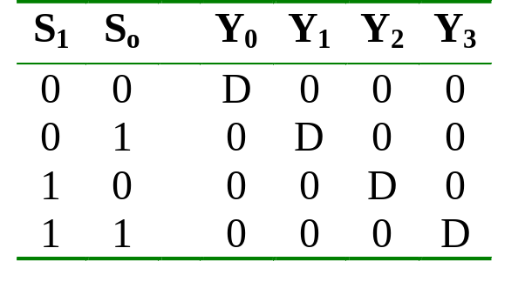
1-to-4 Demultiplexer
Outputs
Y₀ = D.S₁'.S₀'
Y₁ = D.S₁'.S₀
Data D
demux
Y₂ = D.S₁.S₀'
Y₃ = D.S₁.S₀
S₁ S₀
select
Y₀ = D.S₁'.S₀'
2x4 Decoder
S₁
S₀
Y₁ = D.S₁'.S₀
Y₂ = D.S₁.S₀'
E
Y₃ = D.S₁.S₀
D
Digital System Design
January 1, 2022

Slide 67
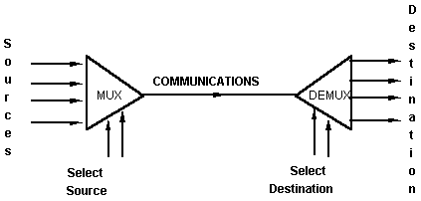
Mux-Demux Application Example
This enables sharing a single communication line among a number of devices.
At any time, only one source and one destination can use the communication line.
Digital System Design
January 1, 2022

Slide 68
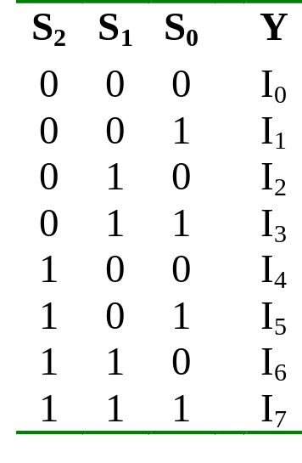
Larger Multiplexers
Larger multiplexers can be constructed from smaller ones.
An 8-to-1 multiplexer can be constructed from smaller multiplexers as shown:
I₀
I₁
I₂
I₃
4:1 MUX
2:1 MUX
S₁ S₀
Y
I₄
I₅
I₆
I₇
4:1 MUX
S₂
S₁ S₀
Digital System Design
January 1, 2022

Slide 69
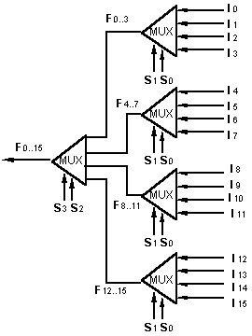
Larger Multiplexers
A 16-to-1 multiplexer can be constructed from five 4-to-1 multiplexers:
Digital System Design
January 1, 2022

Slide 70
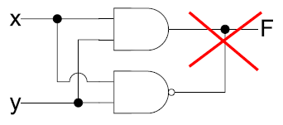
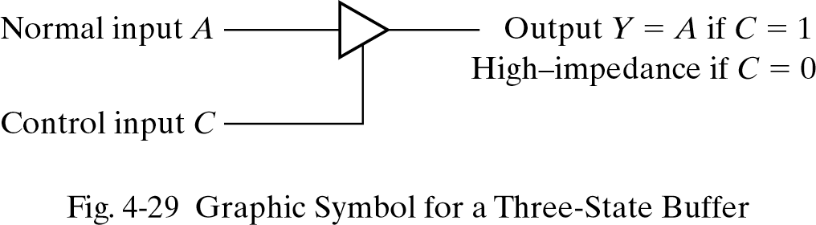
Three-state (Tri-State) gates
What is the truth table for F ?
The two gates will try to drive F at the same time
  Not a good idea to wire their outputs
Sometimes it is necessary to “disconnect” a gate
Three state:
  0 or 1 Boolean value
  “High impedance”, Z state
High impedance acts as if gate were disconnected
Digital System Design
January 1, 2022

Slide 71
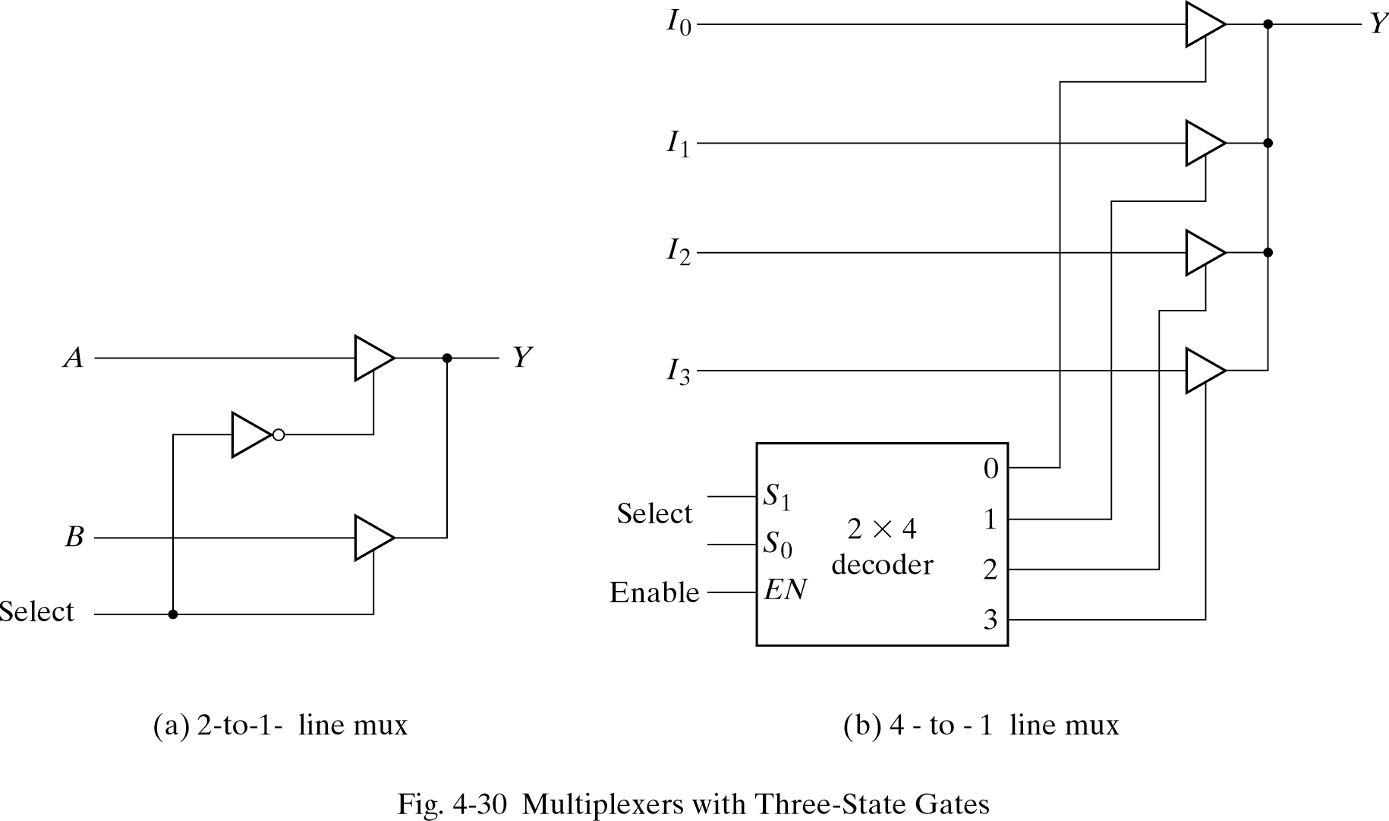
Multiplexer with Tri-state Gates
Digital System Design
January 1, 2022

